Slide 1

Intrusion Detection & Prevention System (IDPS)
Group 2
Yang Cao, Ali Akber, Sai Karthikeyan, Shruti Kulkarni, Shiva Manikanta, Jesus Reyes

Slide 2

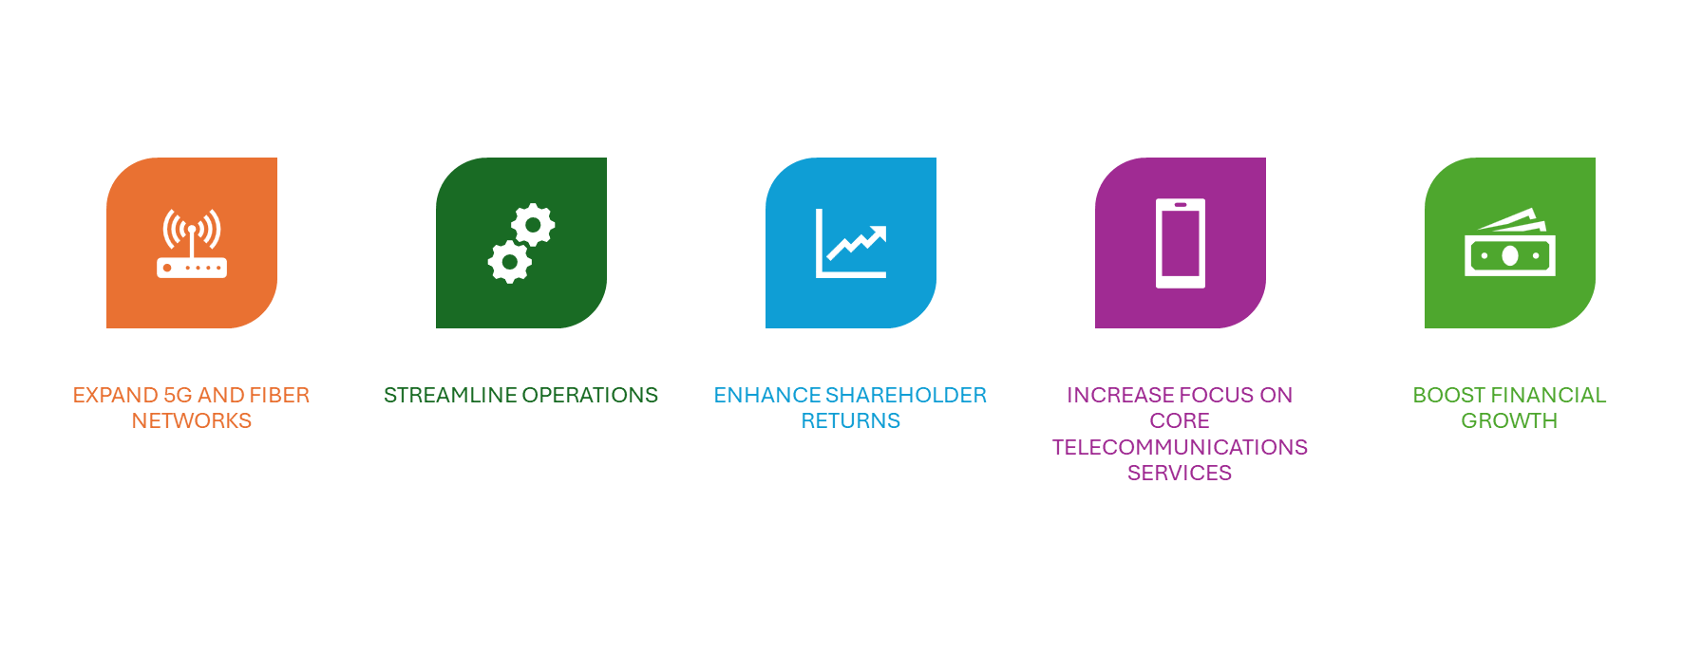
American Telephone and Telegraph Co., U.S.
Revenue
Diluted EPS
Operating Income
$32.3 Billion
$0.56
$5.4 Billion
Net Income
$4.4 Billion
EBITDA
$10.8 Billion
Cash from Operations
$11.9 Billion
STRATEGIC OBJECTIVES
Telecom Products
Wireless plans
Internet
Voice
Network Services
Cyber
security

Slide 3
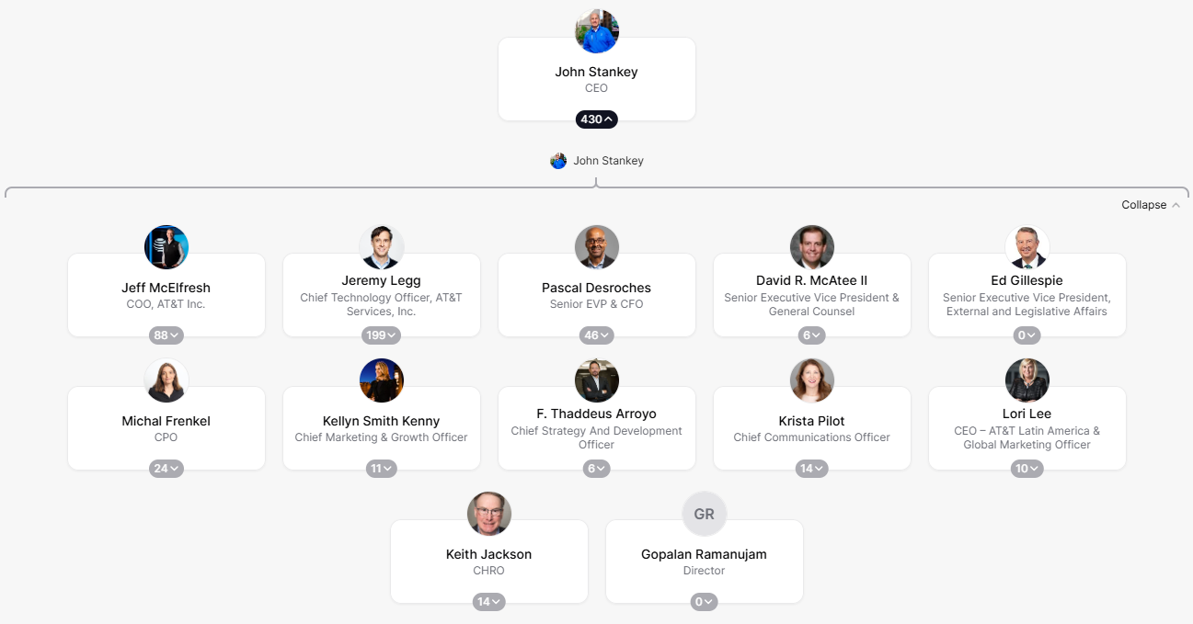
Company
Management
Relevant Company Policies
AT&T Code of Business Conduct
Ethical & Legal Standards
Privacy Policy & Data Protection
Regulations: GDPR and CCPA
Accounting Methodology
Following GAAP
Corporate Ethics & Compliance team oversee financial reports
Corporate Governance & Compliance
NYSE requirements & SOX
Cybersecurity & IT Policies
Network Security & Incident Response Protocols
Environmental, Social, Governance
Workplace and Employment Policies

Slide 4

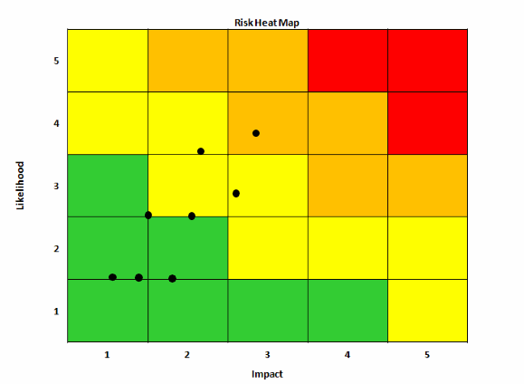
Risk Assessment & Analysis
Key Risks Identified:
Risk | Impact | Likelihood | Rating
Failure to detect new threats | Medium | Medium | 2
False Positives/Negatives | Medium | Medium | 4
System Overload | Medium | Low | 4
Evasion Techniques | Medium | Low | 2
Insufficient System Updates | Medium | Low | 2
Resource Exhaustion | Low | Low | 1
Inadequate Response Mechanisms | Low | Low | 1
Unauthorized Configuration Updates | Medium | Low | 2

Slide 5








Management Control Assessment
Automated Incident Response Protocols
Continuous Monitoring
Automated System Updates
Automated Load Balancing
Adjust & Modify Detection Algorithms
Track Resource Allocation
Strict Access Controls
Advanced Detection Tools & Techniques

Slide 6
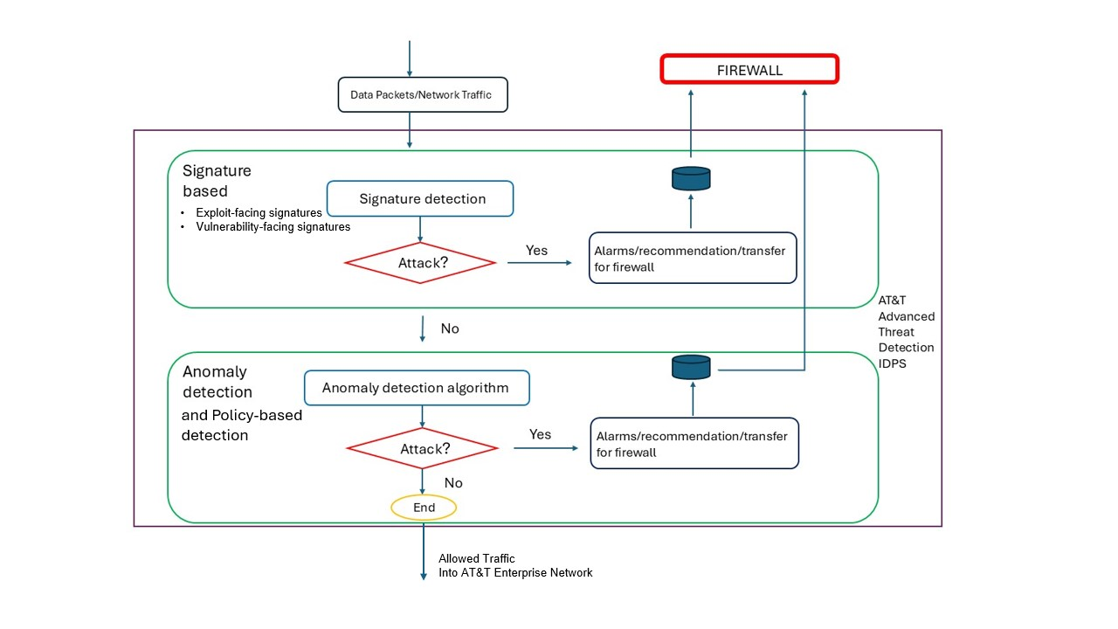

Slide 7


Audit Program with Audit Steps
Planning & Scoping
Review Risk Assessment
Define Audit Scope
Identify Compliance Standards (OWASP, NIST SP 800-53.Rev.5)
2. Firewall Configuration Review
Test Procedure (Rulesets, IP Whitelisting/Blacklisting)
Evasion Technique Testing (Fragmented packets, Encrypted payloads)
3. IPS/IDS Effectiveness Testing
Signature & Anomaly Detection (False positives/negatives)
Performance Under Load (High traffic volumes, Auto-scaling)
4. Patch & Update Management
Automated Updates (Signature/Rules updates/Patch deployment log)
Unauthorized Changes (Version controls/ access controls)
5. Incident Response Evaluation
Simulate Attacks (Malicious traffic, Detection time, Response effectiveness)
Review Escalation Protocols (NIST SP 800-61.Rev.3)
6. Reporting & Recommendations
Document Findings (Gaps, Strengths)
Prioritize Remediation (Critical, Moderate)
Tools and References
Testing tools: Nmap, Wireshark, Metasploit, Nessus
Standards: OWASP, NIST SP 800-53.Rev.5
References: America’s Cyber Defense Agency, CVE.org

Slide 8

Risk Control Matrix
Risk ID | Risks | Risk Description | Risk Rating | Control Objective | Control Description | Control Type | Control Frequency
IDPS-01 | Failure to detect new threats | New or sophisticated attacks that don't match existing signatures may bypass signature and anomaly detection, leaving the network vulnerable | 2 | Implement continuous monitoring and regular updates to signature-based and anomaly detection systems to ensure the detection of emerging threats | Regular updates of signatures and detection rules to be automated and continuous monitoring performed to identify new attack patterns | Detective | Multiple Times Per Day
IDPS-02 | False Positives /Negatives | The IDPS may generate false alarms (false positives) or fail to detect real attacks (false negatives), causing unnecessary disruptions or missed security threats | 4 | Fine tune detection algorithms and ensure regular updates for enhanced performance | Detection thresholds are regularly adjusted and refined to minimize false alarms. Machine learning algorithms and advanced AI is utilized to adapt detection logic based on historical data | Detective | Multiple Times Per Day
IDPS-03 | System Overload | Overloading or misconfiguration can slow response times or cause system crashes, affecting detection effectiveness | 4 | Implement load balancing and scalability measures to ensure the system can handle high volumes of traffic without any impact on performance or system failure. | Automated load balancing and dynamic resource allocation is utilized to prevent system overload and continuous monitoring tracks resource usage. Optimization reviews are conducted periodically to maintain system performance | Preventative | Daily
IDPS-04 | Evasion Techniques | Attackers may use techniques like packet fragmentation or encryption to bypass IDPS detection. | 2 | Utilize advanced threat detection capabilities, including deep packet inspection and behavioral analysis, to detect and block evasion techniques such as packet fragmentation and encryption. | Advanced detection tools including behavioral analysis are used to detect evasion techniques | Preventative | Multiple Times Per Day
IDPS-05 | Insufficient System Updates | Failure to update signatures and detection rules regularly; resulting in exposure of the network to new threats | 2 | Ensure a robust update schedule to ensure timely and relevant updates including patches for vulnerabilities. | Automated system updates in place with a patch management process to verify that all system components are up to date. | Preventative | Daily
IDPS-06 | Resource Exhaustion | High resource usage can cause performance bottlenecks, reducing the effectiveness of the IDPS in high-traffic environments | 1 | Optimize resource allocation and implement performance monitoring tools to identify and mitigate resource consumption | System resource usage is continuously monitored, automated scaling is used to allocate sufficient resources and performance optimization is conducted regularly. | Preventative | Weekly
IDPS-07 | Inadequate Response Mechanisms | Lack of automated responses or poorly defined procedures may delay or fail to mitigate detected intrusions | 1 | Develop and automate incident response protocols, including clear escalation procedures and integration with other security systems | Automated incident response protocols are implemented for quick action on detected threats while manual escalation procedures are defined for complex incidents. Regular training is conducted for cybersecurity personnel. | Corrective | Ad Hoc
IDPS-08 | Unauthorized Configuration Updates | Unauthorized system/code updates or unintended changes are released during patch or complete updates | 2 | Implement strict access control mechanisms, approval workflows, and version control for configuration changes | Strict access controls and approval workflows are enforced for configuration changes. Version control is used to track changes and maintain audit logs | Preventative | Weekly

Slide 9





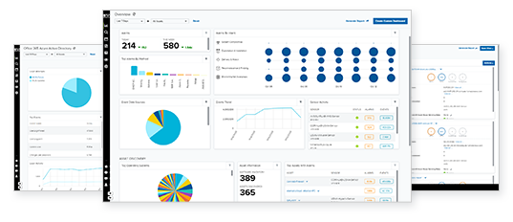
Audit Fieldwork
Engagement Planning
Risk Assessment
Internal Controls
Testing Procedures
Documentation
Define audit scope and objectives.
Assemble audit team with appropriate skills and expertise in IDPS auditing and telecom industry regulatory compliance.
Identify risks in AT&T’s 5G, fiber, and cybersecurity systems, focusing on SNOC and IDPS.
Evaluate access management, patching, EDR, and SIEM processes for effectiveness.
Validate intrusion logs, SIEM alerts, and endpoint responses across network layers.
Ensure workpapers align with SOX, NIST, and telecom regulatory standards.

Slide 10

Recommendations
Recommendation:
Adjust detection thresholds to fine-tune the
balance between sensitivity and accuracy.
Regularly review and update
detection rules to improve response
to traffic and real threats.
EVALUATE
ID: 345
60%
ID: 346
Recommendation:
Establish a process for regular updates
to detection rules and signatures based
on new threat intelligence. Ensure that
updates are scheduled in a timely
manner to keep the detection system current.
False Positives/Negatives
ID: 347
40%
Recommendation:
Implement machine learning models
that can self-adjust detection rules
based on incoming data and detected
patterns. Regularly train
the models to ensure they
remain effective as new threats evolve.
PROPOSE
ID: 339
Recommendation:
1) Update Firewall Rules
2) Enhance Deep Packet Inspection
3) Regular Review and Testing
Evasion Techniques

Slide 11
References
https://www.business.att.com/
https://theorg.com/org/att
https://www.techtarget.com/searchsecurity/feature/Introduction-to-Information-Security-A-Strategic-Based-Approach
https://www.mdpi.com/2079-9292/8/5/500
https://www.sciencedirect.com/science/article/pii/S111086652400080X
https://www.researchgate.net/publication/380570823_Evaluating_modern_intrusion_detection_methods_in_the_face_of_Gen_V_multi-vector_attacks_with_fuzzy_AHP-TOPSIS
https://powercyber.ece.iastate.edu/powercyber/download/publications/9.pdf
https://nvlpubs.nist.gov/nistpubs/SpecialPublications/NIST.SP.800-128.pdf
https://hightable.io/iso27001-annex-a-8-32-change-management/
https://www.rapid7.com/fundamentals/intrusion-detection-and-prevention-systems-idps/
Thank you!

